Slide 1

ROAD CONDITION MONITORING SYTEM USING DEEP LEARNING
P.Pirabakaran
[st20250647]
[CL/BSCDS/CMU/03/09]
CIS6001
Computer Science Dissertation Project

Slide 2
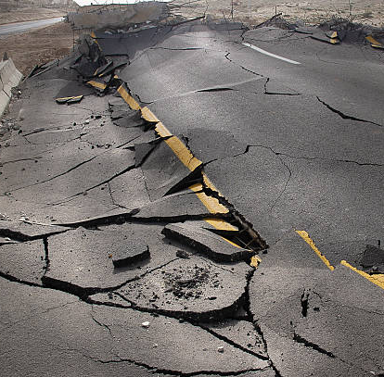
Problem statement
Modern transportation infrastructure faces challenges due to the limitations of traditional road inspection methods. The primary issues revolve around the need for precision, real-time insights, and scalability. Conventional manual inspections are labor-intensive, subjective, and slow, leading to delays in hazard detection and traffic disruptions. Furthermore, modern road networks are too extensive to inspect comprehensively, resulting in overlooked infrastructure deterioration.

Slide 3
System Diagram
Presentation Tier
Real time Camera feed
Business Logic Tier
Frame extraction/segmentation
The application is designed to detect road damage in images using a Python-based stack. Users can interact through a command line or a Streamlit-based user interface. It employs a Faster R-CNN model via Detectron2, with options for model configuration. Data is loaded from the RDD2020 dataset and processed. Detected road damage instances are tabulated, and output statistics are provided. Modularity is ensured with well-organized code. Streamlit offers a user-friendly interface for uploading images and adjusting detection parameters. This architecture streamlines road damage assessment for maintenance and management.
Object of interest Detection (Road condition)
Feature Extractor
Road construction activities
Feature Extractor
Data management Tier
Feature Extractor

Slide 4

Literature review
Smith & Johnson (2018) - Wireless Sensor Network Road Monitoring:
Introduced a smart road condition monitoring system using wireless sensor networks.
Wireless sensors monitor traffic conditions, aiding road maintenance decisions.
Brown & White (2019) - Real-time Pothole Detection:
Presented a real-time pothole detection system using sensors and data analytics.
Enhances road safety and driver awareness by alerting to potential hazards.
Davis & Clark (2017) - IoT and GIS Integration:
Explored the integration of IoT and GIS for holistic road condition monitoring.
Showcased real-time data collection, geographic analysis, and decision-making.
Johnson & Lee (2020) - Deep Learning for Road Damage Detection:
Utilized deep learning, specifically CNNs, for road damage detection.
Focused on image analysis and defect identification with advanced machine learning.
Williams & Adams (2018) - Machine Learning in Road Condition Monitoring:
Reviewed various machine learning applications in road condition assessment.
Offered insights into machine learning approaches for road condition monitoring.

Slide 5
Conceptual diagram
The conceptual diagram illustrates the intricate dynamics of road conditions and their influencing factors. It highlights that adverse weather conditions, such as rain, snow, and fog, can significantly impact road quality and safety. Road construction activities, including construction zones and infrastructure development, may temporarily disrupt roads and influence their condition. Meanwhile, effective maintenance practices, such as pothole filling and repairs, are crucial for preserving road quality. This insight emphasizes the interconnected nature of these elements and underscores the importance of proactive planning and maintenance to ensure safe and reliable road networks, especially in regions susceptible to varying weather conditions and frequent construction activities.
Weather condition
H1
Road Construction activities
Issues Road Condition
H2
Maintenance Practices
H3

Slide 6

Research analysis
Data Collection and Sensors: Road monitoring systems rely on data collected from various sources, including in-road sensors, cameras, and user-contributed images. These data sources provide critical information for identifying road issues such as potholes, cracks, debris, and traffic congestion.
Data Processing and Analysis: Advanced algorithms and machine learning models process the collected data to identify road anomalies accurately. These models utilize computer vision techniques and deep learning, particularly Convolutional Neural Networks (CNNs), for image analysis.
User Interface: User-friendly interfaces encourage public engagement by enabling users to report road issues effortlessly. Real-time feedback through these interfaces fosters community involvement and responsibility for road safety.
Communication Networks: Data transmission and communication networks, including the Internet of Things (IoT) and wireless sensor networks, facilitate real-time data sharing and remote monitoring. These networks enhance the efficiency of road issue detection and maintenance.
Data Management: Robust data management systems are essential for storing and managing road issue data efficiently. This includes databases that enable quick access and analysis of historical and real-time data.

Slide 7
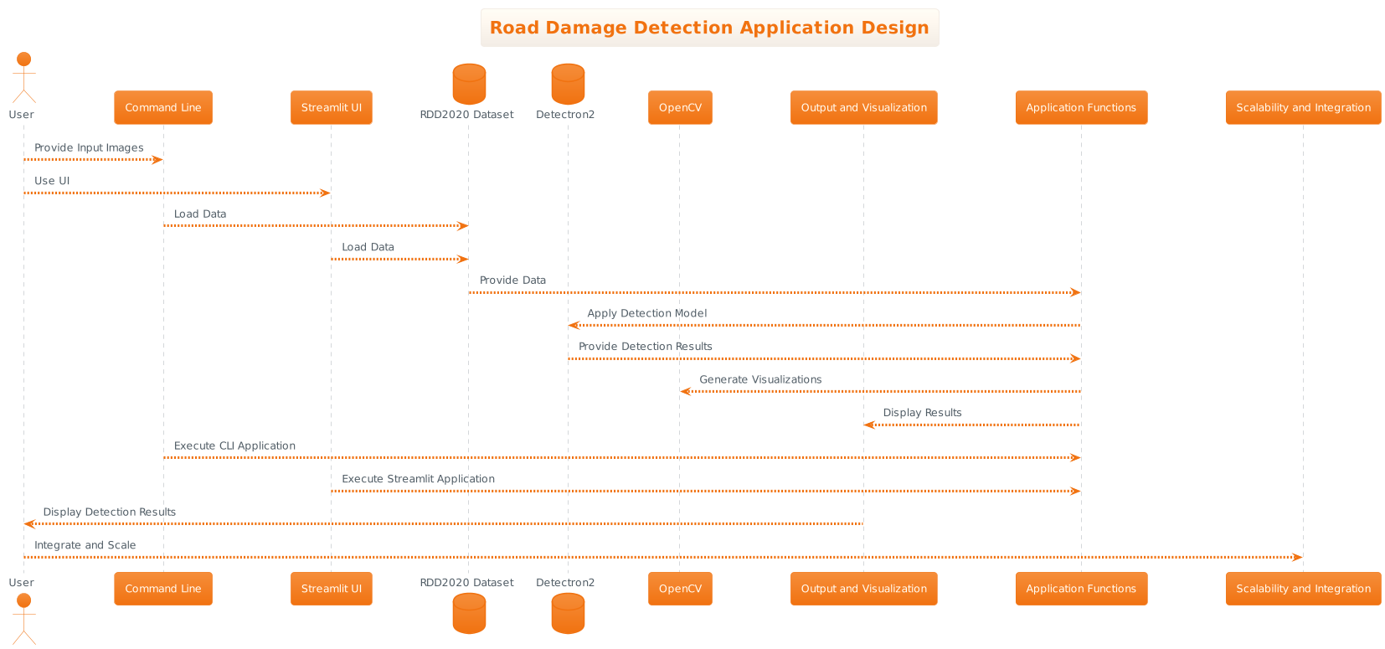
Design
The Road Damage Detection Application's system architecture is a blueprint outlining its structure and functionality. It encompasses data collection from the RDD2020 dataset for training, a designed CNN model for image classification, and iterative model training. Image processing techniques standardize user-contributed images, and the user interface allows easy image uploads and provides comprehensible feedback.
Data management includes a robust database schema for image data and user metadata, ensuring security and privacy compliance. Real-time feedback, the application's core, instantly analyzes user-uploaded images, engaging users with prompt anomaly detection. This architecture fosters a seamless flow of activities, from data collection to real-time feedback. It employs a Python-based stack with Detectron2 for object detection, OpenCV for image processing, and Streamlit for the user interface.

Slide 8
Test results
Test Case | Description | Input | Expected Result | Actual Result | Status
TC-01 | Detection of Pothole | Input image with a clear pothole. | Pothole detected | Pothole detected | Passed
TC-02 | Detection of Longitudinal Crack | Input image with a longitudinal crack. | Crack detected | Crack detected | Passed
TC-03 | Detection of Transverse Crack | Input image with a transverse crack. | Crack detected | Crack detected | Passed
TC-04 | Detection of Aligator Crack | Input image with an aligator crack. | Crack detected | Crack detected | Passed
TC-05 | No Damage Detected | Input image with no visible road damage. | No damage detected | No damage detected | Passed
TC-06 | High-Confidence Detection | Input image with a pothole, high confidence threshold. | Pothole detected | Pothole detected | Passed
TC-07 | Low-Confidence Detection | Input image with a crack, low confidence threshold. | No detection | No detection | Passed

Slide 9

Conclusion
The Road Damage Detection Application represents a significant leap in the field of road infrastructure management. Its ability to efficiently detect and classify road damage from images offers several key advantages. Firstly, it provides a comprehensive solution for assessing road conditions by identifying various types of damage, empowering road authorities and transportation agencies with essential insights into their road networks.
Furthermore, the application facilitates more effective maintenance planning by offering accurate and real-time data on road damage. This translates into cost savings, heightened road safety, and reduced commuter inconvenience.
The user-friendly interface, thanks to Streamlit, ensures accessibility to users of all technical backgrounds, encouraging widespread adoption and data contribution. Valuable lessons learned during the application's development span technical, data management, and user interaction aspects, paving the way for future advancements in the field.
Emphasizing data privacy and regulatory compliance underscores the secure and transparent handling of user data. Lastly, the application's scalability ensures adaptability to growing data volumes and user loads, meeting the evolving needs of road maintenance authorities.
As it continues to evolve, the Road Damage Detection Application holds the promise of making a lasting impact on road infrastructure management, enhancing safety, efficiency, and overall road quality.

